Slide 1

DS-TransUNet: Dual Swin
Transformer U-Net
for Medical Image Segmentation Amne Slame 322732561 Danial Jarrous 211844881

Slide 2

Overview
Introduction
What is image segmentation?
Different kinds of image segmentation
Medical image segmentation
Related work
U-NET
Transformers
Vision Transformers
Multi-Scale Transformer
Our method
Encoder Decoder
Swin Transformers Block
Transformer Interactive Fusion Module (TIF)
Datasets and Evaluation
Results

Slide 3

Life or Death?

Slide 4
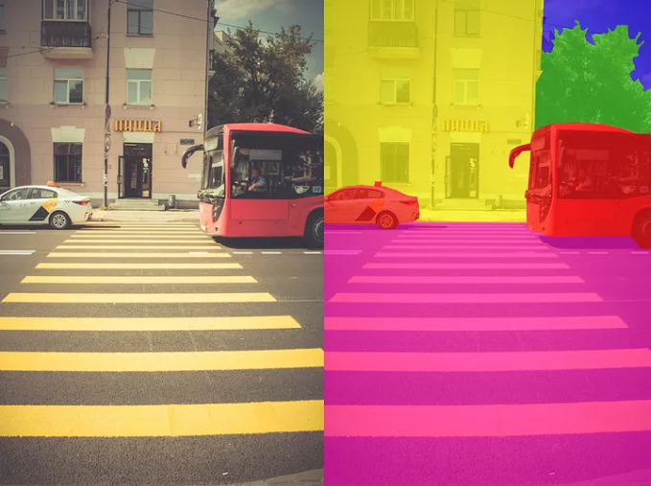
Image Segmentation
What is Image Segmentation?
Image segmentation involves partitioning the image into smaller parts called segments. Segmentation involves understanding what is given in an image at a pixel level. It provides fine-grained information about the image as well as the shapes and boundaries of the objects. The output of image segmentation is a mask where each element indicates which class that pixel belongs to
The goal is to simplify and/or change the representation of an image into something that is more meaningful and easier to analyze.
Types:
Semantic Segmentation: Classifies each pixel into a predefined category.
Instance Segmentation: Distinguishes between different instances of the same object.
Panoptic Segmentation: Combines semantic and instance segmentation.
Notes:
Introduction:
"Now, let's delve into the concept of image segmentation, which is fundamental to understanding our work on DS-TransUNet."
Definition:
"Image segmentation involves partitioning an image into smaller parts called segments. This process requires understanding the contents of an image at the pixel level, providing detailed information about the image's objects, their shapes, and boundaries. The output of image segmentation is typically a mask, where each element indicates which class that pixel belongs to."
Explain the Goal:
"The primary goal of image segmentation is to simplify or alter the representation of an image, making it more meaningful and easier to analyze. By segmenting an image, we can extract relevant features and information that are crucial for various applications."

Slide 5
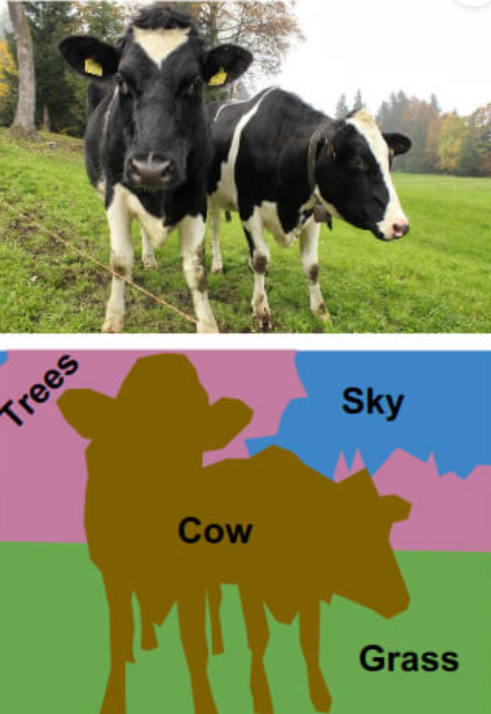
Semantic segmentation
The process of semantic image segmentation involves finding objects inside an image and categorizing them according to predetermined categories. This entails merely assigning a class name to each pixel in an image that corresponds to the thing it is meant to represent.
Notes:
"Let's start by looking at semantic segmentation."
Definition:
"Semantic segmentation classifies each pixel in an image into a predefined category. This means that each pixel is labeled with the class of object it belongs to, without distinguishing between different instances of the same object."
Example:
"For example, you might want to group several flower varieties according to their hue. The semantic segmentation model can be trained to recognize flowers in an image based on their color. It can then classify a collection of photos of flowers with the same hue into several categories. For instance, images with red flowers can be grouped into category 1, images with blue flowers into category 2, and images with yellow flowers into category 3."

Slide 6
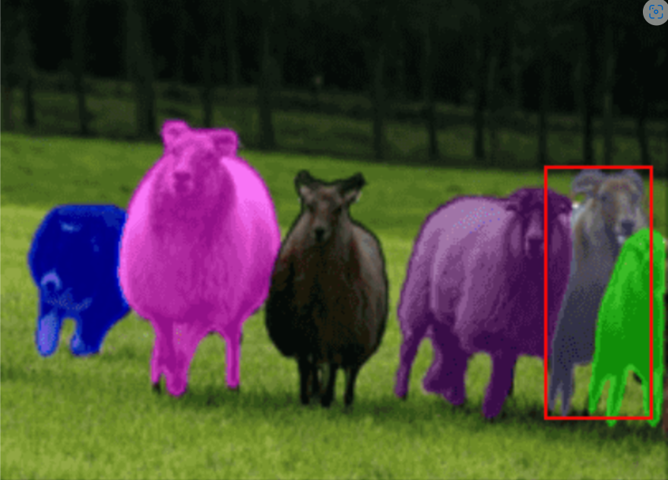
Instance Segmentation
By finding things that fall within the specified categories, instance segmentation advances semantic segmentation. In contrast to semantic segmentation, instance segmentation involves localizing particular objects based on the relationship of the pixels that correspond to them. It makes development more difficult. the need for per-pixel segmentation masks and object instance prediction.
Notes:
Instance segmentation goes a step further than semantic segmentation by distinguishing between different instances of the same class. This means it not only classifies each pixel but also identifies individual objects within the same category."
Example:
"For example, if our objective is to locate sheep in a given image, we may use the instance image segmentation approach to identify those animals. The model will not only identify the sheep but also help us distinguish them from one another. Unlike semantic segmentation, which would label all sheep with the same class without distinguishing between them, instance segmentation assigns unique labels or shades to each sheep, allowing us to differentiate between individual animals."

Slide 7
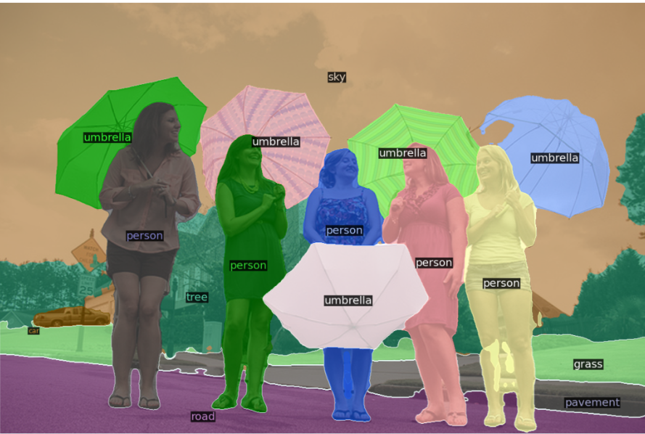
Panoptic Segmentation
Semantically differentiating various objects by panoptic segmentation, which also detects distinct instances of each type of item. In other words, panoptic segmentation gives each pixel in an image two labels: a semantic label and an instance ID.
Notes:
Panoptic segmentation combines the strengths of both semantic and instance segmentation. It provides a unified approach that not only classifies each pixel into a category but also distinguishes between different instances of objects within those categories."
Example:
"For example, imagine an image of a busy street scene with several humans and umbrellas. Panoptic segmentation can identify and label each pixel as belonging to a 'human' or 'umbrella,' providing semantic context. At the same time, it distinguishes between different instances of humans and umbrellas, ensuring that each person and each umbrella is individually recognized. This comprehensive segmentation allows us to understand both the category and the individual instances within the scene, providing detailed and precise information."

Slide 8
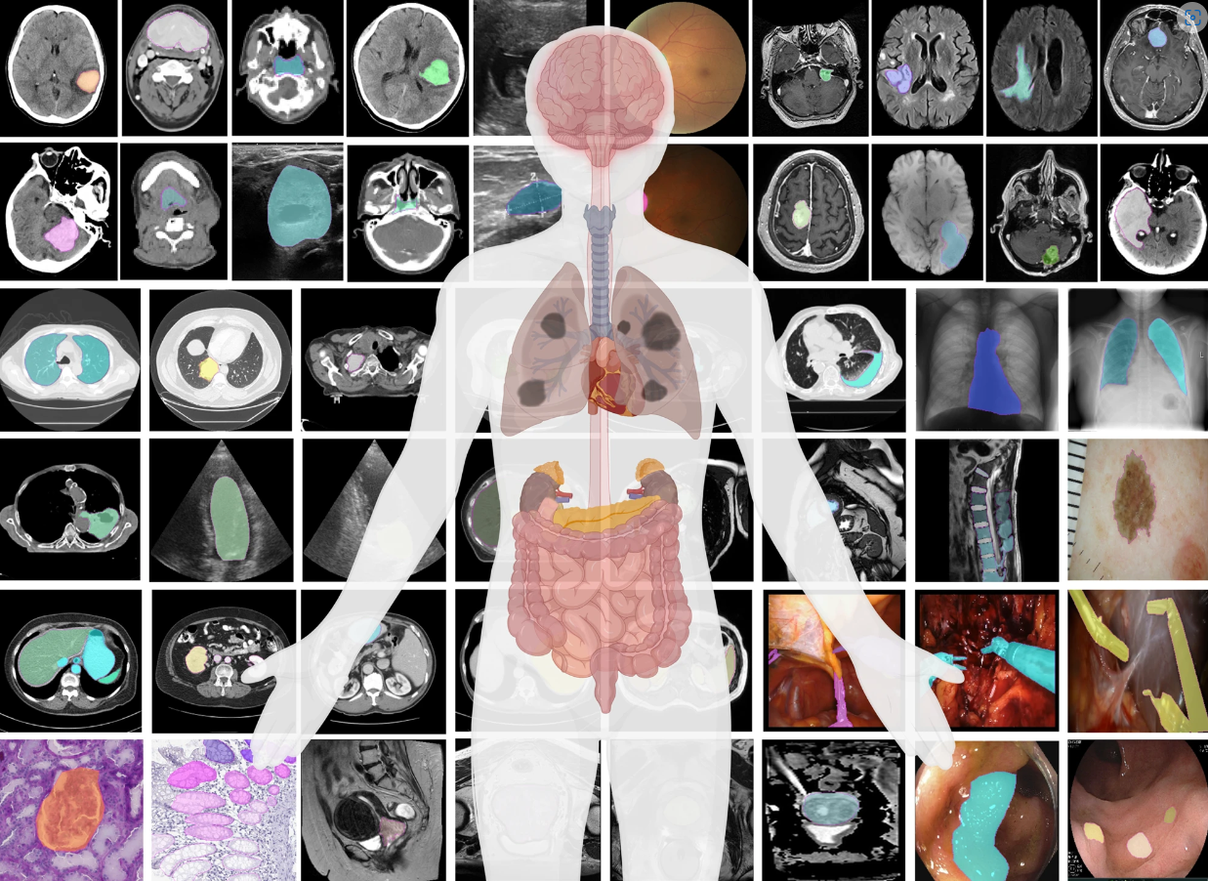
Medical Image Segmentation
Definition:
Medical image segmentation involves dividing medical images into regions that correspond to different anatomical structures or areas of interest. This process is crucial for detailed analysis and diagnosis.
Purpose:
Accurate Visualization: Provides clear visualization of anatomical structures and pathological findings.
Enhanced Analysis: Facilitates precise measurement and analysis of structures and abnormalities.
Improved Diagnosis: Supports accurate diagnosis and treatment planning.
Examples of Clinical Applications:
Polyp Segmentation
Lesion Segmentation
Cell Segmentation
Notes:
"Medical image segmentation involves dividing medical images into distinct regions that correspond to different anatomical structures or areas of interest. This process is crucial for detailed analysis and accurate diagnosis."
Purpose:
"The primary purposes of medical image segmentation are:
Accurate Visualization: It provides a clear visualization of anatomical structures and pathological findings. This clarity is essential for understanding complex medical images.
Enhanced Analysis: By segmenting images, we can perform precise measurements and detailed analyses of various structures and abnormalities.
Improved Diagnosis: Accurate segmentation supports better diagnosis and treatment planning by clearly defining the areas of concern."
Examples of Clinical Applications:
"Here are a few clinical applications of medical image segmentation:
Polyp Segmentation: Identifying and outlining polyps in colonoscopy images to facilitate early diagnosis and intervention.
Lesion Segmentation: Detecting and analyzing lesions in MRI or CT scans to monitor disease progression and plan treatments.
Cell Segmentation: Differentiating and counting cells in microscopic images for research and diagnostic purposes."
Impact:
"Medical image segmentation plays a crucial role in saving lives. By enabling early detection and precise treatment planning, it significantly improves patient outcomes and supports effective medical care."

Slide 9
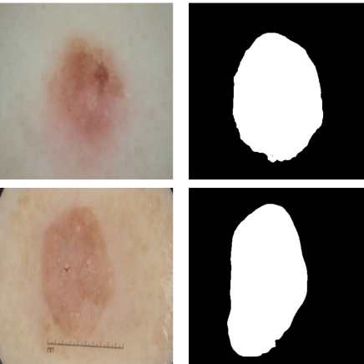
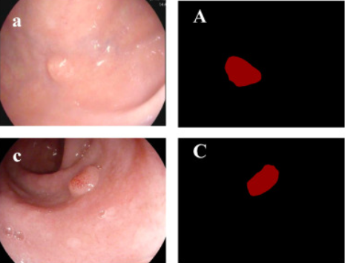
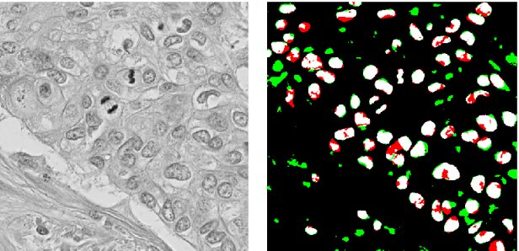
Skin Lesion segmentation
(dermoscopic image)
Segmentation of Gastric Polyps (colonscopy image)
Cell Segmentation
(microscopic image)
Notes:
Polyp Segmentation (Show Photo)
"In colonoscopy images, segmenting polyps helps in identifying and outlining them for early diagnosis and intervention. Here, you can see an example where the polyp is highlighted within the colonoscopy image."
Lesion Segmentation (Show Photo)
"In MRI or CT scans, segmenting lesions allows for the detection and analysis of abnormalities. This photo illustrates how lesions are segmented to monitor disease progression and plan treatments."
Cell Segmentation (Show Photo)
"For microscopic images, cell segmentation helps in differentiating and counting cells. This image shows how individual cells are segmented to aid in research and diagnostic purposes."
"Given the immense importance of medical image segmentation, it is essential to continuously explore and develop advanced methods to enhance its effectiveness. With this in mind, let’s take a closer look at the current methods being used in medical image segmentation."

Slide 10
Current Methods in Medical Image Segmentation
In this section, we'll cover the most prominent CNN-based methods for medical image segmentation, explore recent developments in vision transformers, especially in segmentation, and review existing methods for multi-scale feature representations. We'll then compare these methods with our proposed approach..
Medical image segmentation based on CNNs
Transformers
Vision Transformer
Multi-Scale Tranformer

Slide 11
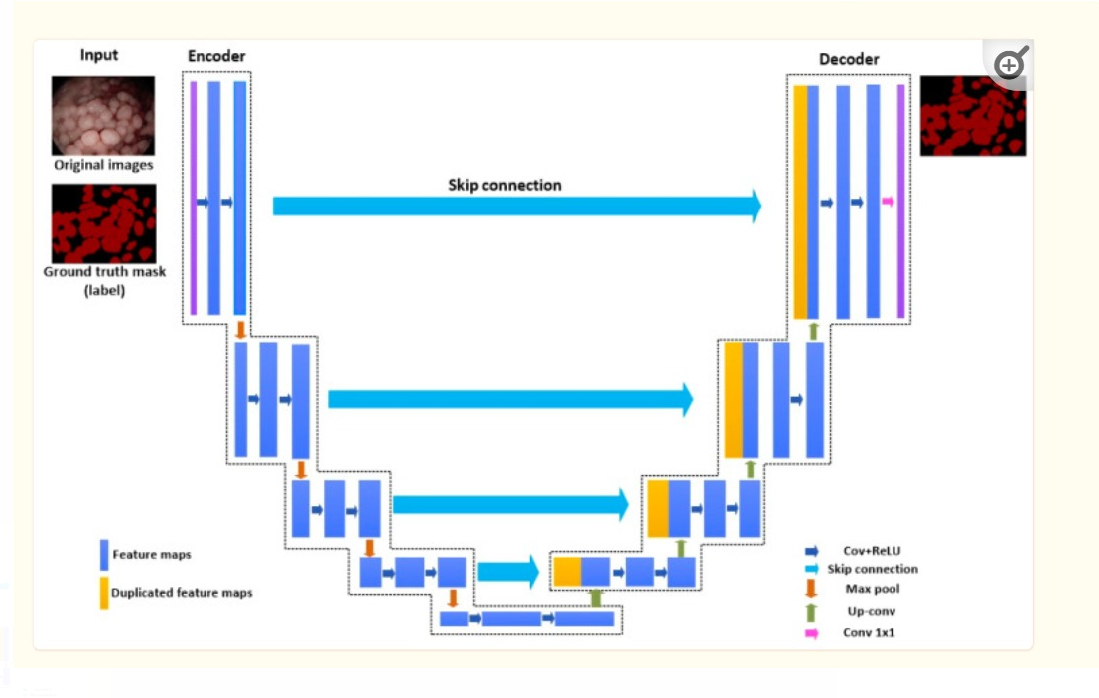
Medical image segmentation based on CNNs U-NET
Encoder: what is in the image?
Downsampling path
Captures features at different levels
Reduces spatial dimensions
Decoder: where exactly are the features we identified in the image?
Upsampling path
Reconstructs image from encoded features
Combines features via skip connections
Skip Connections:
Connect corresponding layers of encoder and decoder
Retain spatial information
Combine low-level and high-level features
Notes:
Since U-Net has already been covered in detail in another presentation, I’ll give a brief overview before moving on to its variants and improvements." UNET is a fully convolutional neural network (FCN) architecture built for image segmentation applications. It was first proposed in 2015 by Olaf Ronneberger, Philipp Fischer, and Thomas Brox. UNET is frequently utilized for its accuracy in picture segmentation and has become a popular choice in various medical imaging applications. UNET combines an encoding path, also called the contracting path, with a decoding path called the expanding path. The architecture is named after its U-shaped look when depicted in a diagram. Because of this U-shaped architecture, the network can record both local features and global context, resulting in exact segmentation results

Slide 12

Introduction to Transformers
Definition: Transformers are a type of deep learning model introduced for sequence-to-sequence tasks.
Origins: Initially developed for Natural Language Processing (NLP).
Key Feature: Utilizes self-attention mechanisms to process input data in parallel, capturing long-range dependencies effectively.

Slide 13
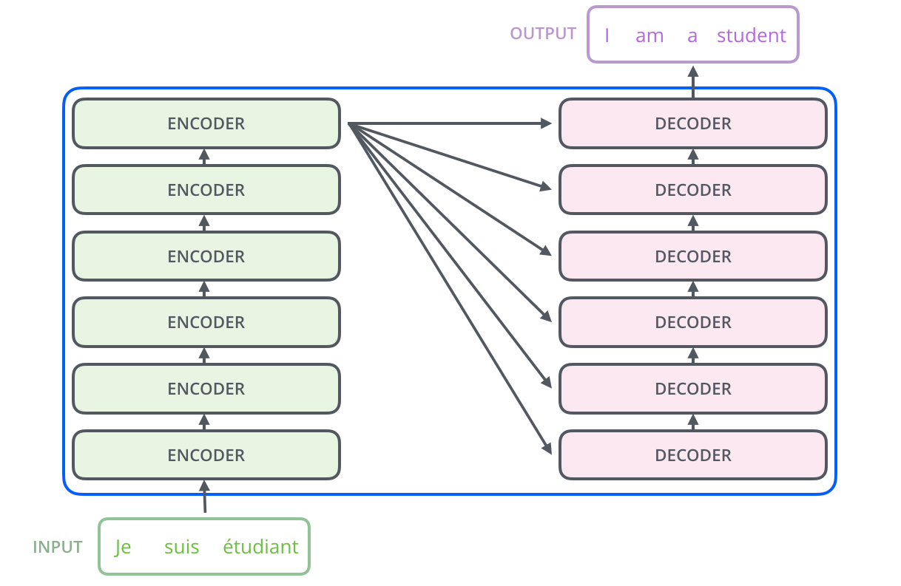
Transformers Architecture Overview
Structure of the Transformer
Components: Encoders and Decoders.
Left part: Represents the Encoder stack.
Right part: Represents the Decoder stack.
Input and Output
Input: "Je suis étudiant" is processed through the Encoders.
Encoders process the input data and transform it into meaningful patterns that the Decoders can use to generate the final output.
Decoders take these transformed patterns to produce the output: "I am a student”.
Notes:
Understanding the Encoder and Decoder in Transformers
Encoder
Purpose: The encoder's job is to process the input data (like text or image patches) and convert it into a format that the model can understand and work with.
Process:
Input: The input data is broken down into smaller pieces (tokens).
Embedding: Each token is turned into a vector (a list of numbers) that represents its meaning.
Self-Attention: This mechanism helps the encoder to understand the relationships between different tokens in the input. For example, in a sentence, it helps the model understand which words are related to each other.
Feed-Forward Network: After self-attention, the data goes through a simple neural network that helps to further process and refine the information.
Layers: This process is repeated through multiple layers to gradually build a detailed understanding of the input data.
Output: The final output of the encoder is a set of vectors that represent the input data in a way that captures its essential features and relationships.
Decoder
Purpose: The decoder's job is to take the processed information from the encoder and generate the output (like translated text or image captions).
Process:
Input: The decoder receives the encoder's output as well as the previous tokens in the output sequence (this is crucial for generating sequences like sentences).
Masked Self-Attention: This ensures the model only considers previous and current tokens in the output sequence, not future ones (important for tasks like translation).
Purpose: Masked self-attention is crucial in the decoder of transformers to ensure that the model generates the output sequence one token at a time, without "peeking" at future tokens.
Reasoning:
Sequential Generation: When generating text, each word is predicted based on the previously generated words and the input sequence.
Avoid Future Outputs: If the model could see future tokens (i.e., the words it hasn't generated yet), it would bias the predictions and not reflect how natural language is generated.
Encoder-Decoder Attention: This mechanism helps the decoder focus on relevant parts of the encoder's output while generating each token in the output sequence.
Feed-Forward Network: Like in the encoder, the data goes through a neural network for further processing.
Layers: This process is repeated through multiple layers to build the final output step-by-step.
Output: The final output of the decoder is the generated sequence (like a translated sentence or a caption).
Simplified Example
Imagine you have a sentence in English ("I am a student") that you want to translate into French.
Encoder: Breaks down the English sentence into words, understands the meaning and relationships between the words, and converts this into a form the model can work with.
Decoder: Takes this processed information and generates the French sentence ("Je suis étudiant"), word by word, while referring back to the encoded information to ensure accuracy.

Slide 14
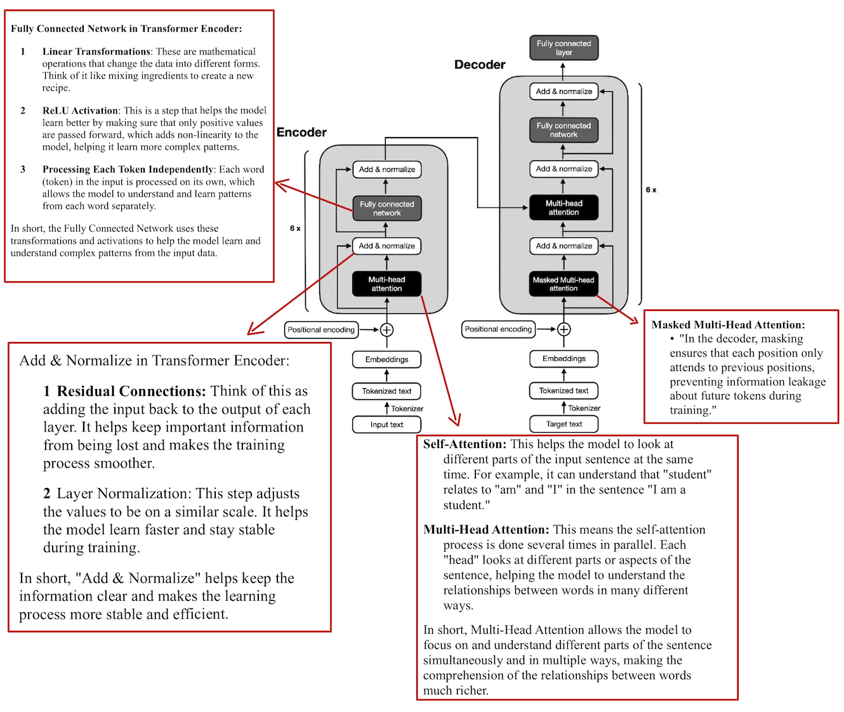
Notes:
Self-Attention: A Basic Explanation
Self-Attention in Simple Terms: Self-attention helps a model focus on relevant parts of the input when making predictions. Think of it as a way for each word (or token) in a sentence to "look at" other words and decide which ones are important for understanding the context.
How Self-Attention Works:
Input Representation: Each word in the input is represented as a vector (a list of numbers).
Calculating Scores:
Each word calculates a score for every other word in the sentence. These scores indicate how much attention each word should give to the others.
Applying Scores:
These scores are converted into probabilities using a softmax function, so they add up to 1.
Each word then takes a weighted sum of the representations of all words, using these probabilities. This means it combines the information from all words, focusing more on the important ones.
Example:
Imagine the sentence: "The cat sat on the mat."
When processing "sat," the model might pay more attention to "cat" and "mat" because they give more context to the action of sitting.
Steps in Self-Attention:
Query, Key, Value Vectors: For each word, create three vectors (query, key, and value) using learned weights.
Attention Scores: Compute scores by taking the dot product of the query vector of one word with the key vectors of all words.
Softmax: Apply the softmax function to these scores to get the attention weights.
Weighted Sum: Multiply each value vector by the corresponding attention weight and sum them up to get the final representation for each word.
Why It’s Useful:
Captures Dependencies: Self-attention captures relationships between all words in a sentence, regardless of their distance from each other.
Parallelizable: Unlike recurrent models, self-attention can be computed in parallel, making it efficient for processing long sequences.
By using self-attention, models can better understand the context and relationships between words, leading to improved performance in tasks like translation, summarization, and more.
---------------------------------------------------------------------------------------------------------------------------------------------------------------------------------------------------------------------------------------------------------
Multi-Head Attention Explanation
Attention Mechanism:
Focuses on different parts of the input sequence to determine which tokens are relevant to each other.
Calculates attention scores, which weigh the importance of different tokens relative to each other.
Multi-Head Mechanism:
Uses several attention mechanisms (heads) in parallel.
Each head operates on a different subspace of the input, capturing various aspects of the relationships between tokens.
The outputs of all heads are concatenated and linearly transformed to produce the final result.
Difference Between Masked Multi-Head Attention and Multi-Head Attention
Masked Multi-Head Attention:
Purpose: Used in the decoder to ensure that predictions for a given position can depend only on known outputs at positions before it.
Function: Masks future tokens in the sequence to prevent the model from "seeing" them, ensuring it can only attend to previous tokens and itself.
Multi-Head Attention:
Purpose: Used in both the encoder and decoder to allow the model to focus on different parts of the input sequence simultaneously.
Function: Allows each position to attend to all positions in the input sequence, enabling the model to capture relationships across the entire sequence.
In summary, the primary difference lies in the masking: Masked Multi-Head Attention restricts attention to previous and current positions (used in the decoder), while Multi-Head Attention can attend to all positions (used in both the encoder and the decoder's encoder-decoder attention).

Slide 15
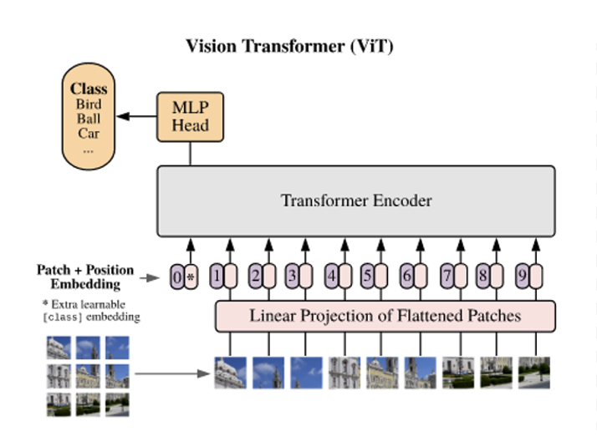
What is Vision Transformers?
Definition:
A Vision Transformer (ViT) is an adaptation of the transformer model designed specifically for image-related tasks in computer vision.
Patch-Based Processing:
The ViT divides an input image into a series of fixed-size patches instead of breaking text into tokens.
How It Works:
Image to Patches: The input image is divided into fixed-size patches.
Patch Embeddings: Each patch is flattened and transformed into an embedding.
Position Embeddings: Positional information is added to embeddings.
Transformer Layers: The sequence of patch embeddings is processed through Transformer layers.

Slide 16
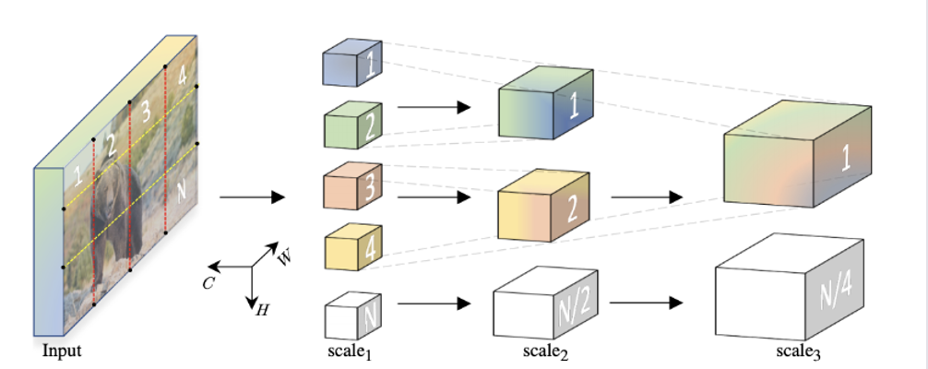
Multi-Scale Transformer
Introduction to Multi-Scale Transformers:
Just like our eyes and brain process visual information at different levels (focusing on small details and big picture), multi-scale transformers do the same for computer vision tasks.
They look at images in different ways (scales) to capture both tiny details and overall structure.
Importance in Computer Vision:
These transformers improve how computers understand and interpret images.
They are particularly good for tasks like identifying objects (object detection) and understanding what's in the image (semantic segmentation).

Slide 17
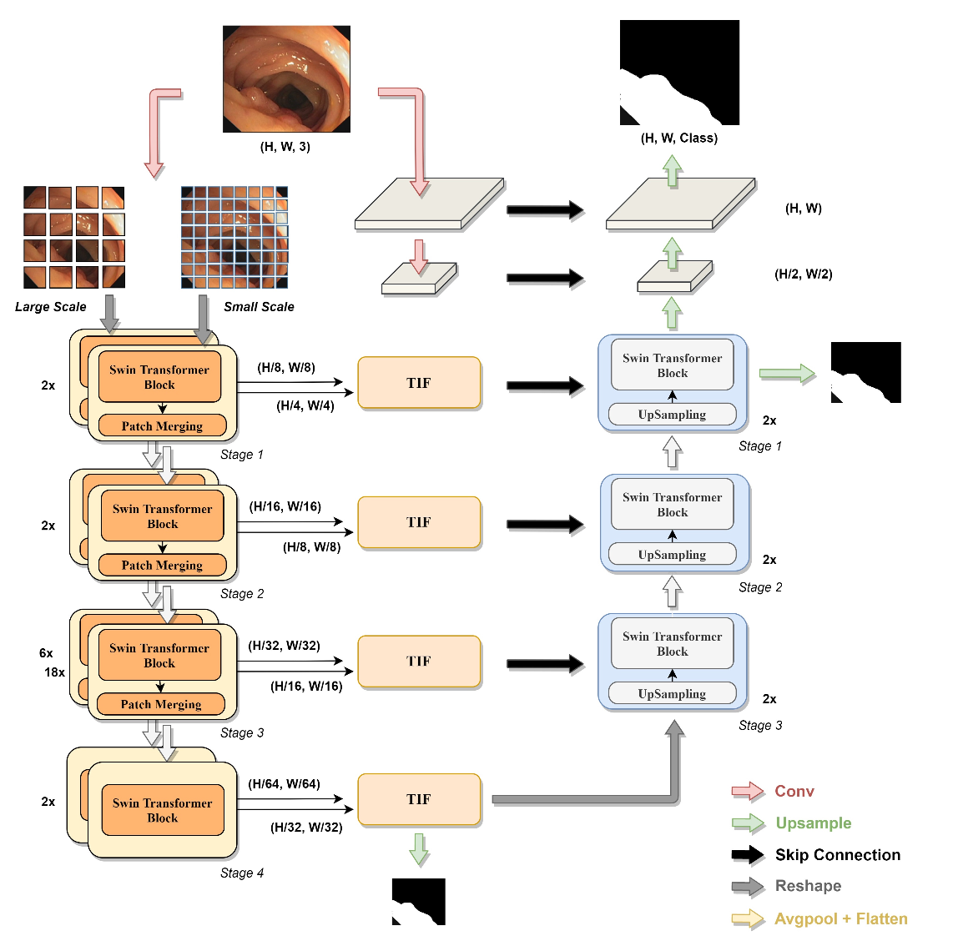
DS-TransUNet
Introduction:
DS-TransUNet, a powerful blend of innovation, stands for Dual Swin Transformer U-Net, combining the strengths of Swin Transformers and U-Net for superior image segmentation.
Components:
U-Shaped Architecture: Combines encoder and decoder for efficient multi-scale feature capture and reconstruction.
Swin Transformer Blocks: Extracts features through hierarchical representation.
Multi-Scale Features: Enhances robustness by capturing features at different scales.
Transformer Interactive Fusion Module (TIF) Module: Fuses multi-scale features with self-attention.
Notes:
Flow :
Input Image:
The input medical image (e.g., (H, W, 3)) is taken and divided into two scales: large scale and small scale.
Patch Division:
Large Scale: The image is divided into larger patches.
Small Scale: The image is divided into smaller patches.
Each patch is then fed into corresponding Swin Transformer Blocks for feature extraction.
Swin Transformer Blocks (Feature Extraction):
Stage 1:
For both large and small scales, patches are processed through Swin Transformer Blocks.
Patch merging occurs to reduce the number of tokens and increase feature dimension.
Output resolutions are H/8 x H/8 for large scale and H/4 x H/4 for small scale.
Stage 2:
Further feature extraction and patch merging.
Output resolutions are H/16 x H/16 for large scale and H/8 x H/8 for small scale.
Stage 3:
Deeper feature extraction with more Swin Transformer Blocks.
Significant reduction in resolution and increase in feature dimension.
Output resolutions are H/32 x H/32 for large scale and H/16 x H/16 for small scale.
Stage 4:
Final stage of feature extraction.
Output resolution is H/64 x H/64 for large scale and H/32 x H/32 for small scale.
Transformer Interactive Fusion (TIF) Modules:
After each stage of Swin Transformer Blocks and patch merging, TIF modules are used to fuse features from both scales.
This fusion helps to integrate multi-scale features, enhancing the model's ability to capture both fine and coarse features.
Decoder Path:
Stage 1:
Features from the TIF module are upsampled to increase the resolution back to H/2 x W/2.
Another set of Swin Transformer Blocks process these upsampled features.
Stage 2:
Further upsampling to H x W resolution.
Processed by another set of Swin Transformer Blocks.
Stage 3:
Final upsampling and processing to match the original input resolution.
Output:
The final processed and upsampled features produce the segmentation map, matching the original input resolution and format (e.g., H x W, Class).

Slide 18
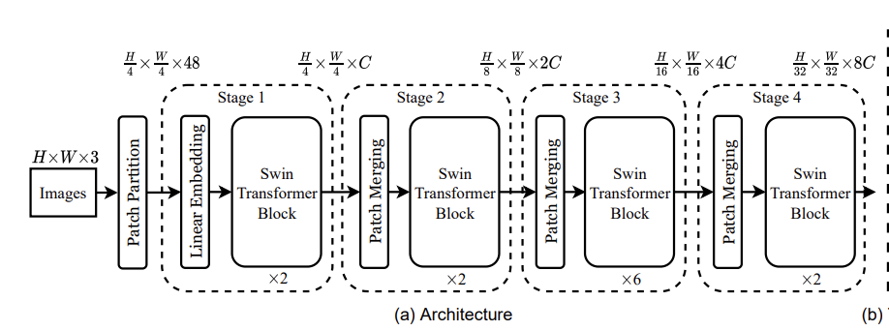


Why Use the Swin Transformer Block?
Challenges with Standard Transformers
Global Self-Attention: Computes relationships between all tokens
Quadratic complexity: Inefficient for high-resolution images and dense predictions
Window based multi head self-Attention:
Efficient and Scalable: Computes attention within small, separate windows, keeping computation fast and manageable for large images.
Shifted Window based multi head self-Attention :
Enhanced Contextual Understanding: Alternates between regular and shifted windows to maintain connections and capture complex features efficiently.

Slide 19
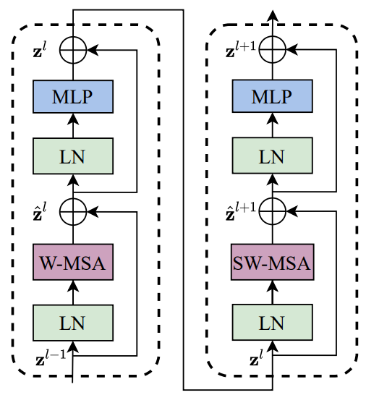
SWIN TRANSFORMER BLOCK
The block is composed of:
LN (layer normalization)
Window based MSA
MLP (Multi-layer perceptron)
Shifted Window based MSA

Slide 20
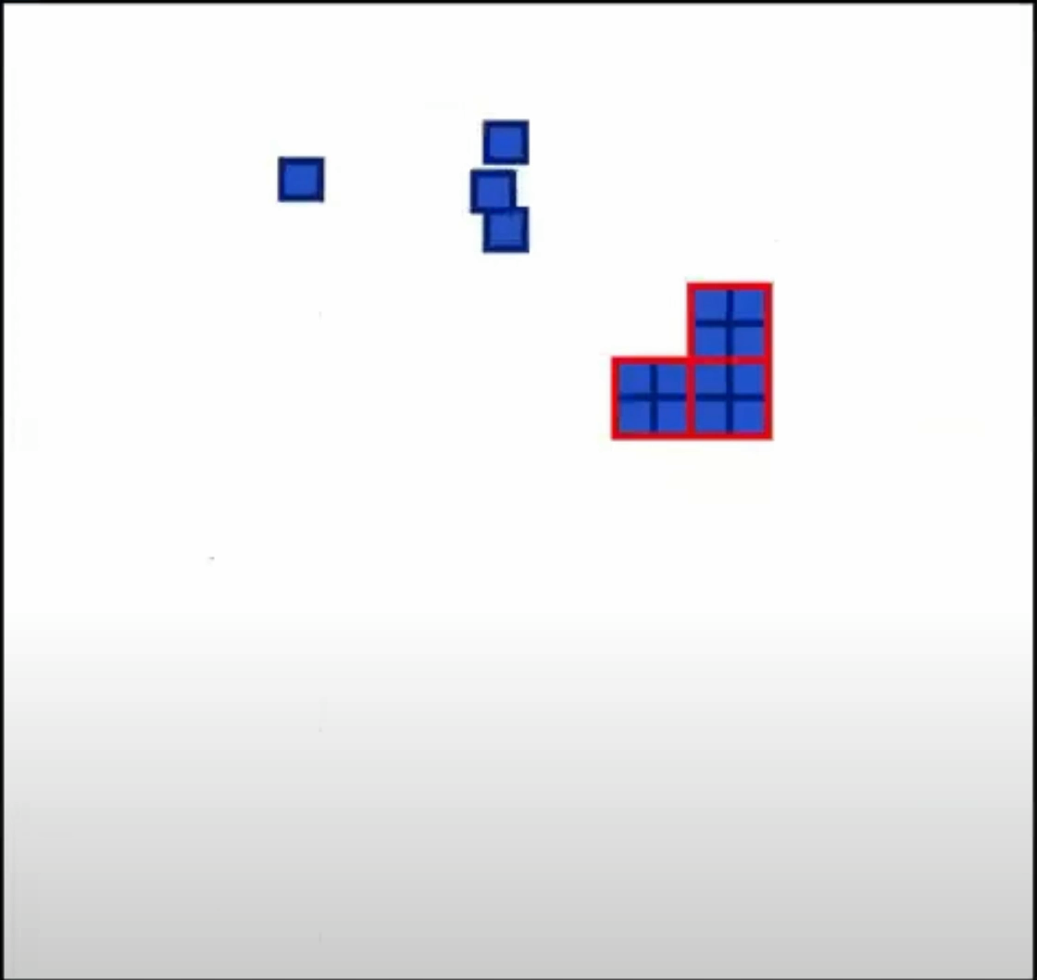
WINDOW BASED - MSA
Window based multi head self-Attention :
Self-attention is calculated only within each window. This means that each token in the window focuses on other tokens within the same window to gather relevant information.
Token Attention Within Windows:
Mechanism: Each token within a window pays attention to every other token in that same window.
Purpose: By attending to all other tokens in the window, each token can gather contextual information from its neighbors, which helps in understanding local features better.
Notes:
The image showing one token connected to three others within a window is a simplified representation to illustrate the concept. In reality, every token within a window attends to every other token in that window in a fully connected manner. The connections shown are meant to depict the general idea of local attention without cluttering the diagram. In window-based MSA, each token's attention calculation involves all other tokens in its window, ensuring comprehensive interaction within the window while maintaining computational efficiency.

Slide 21
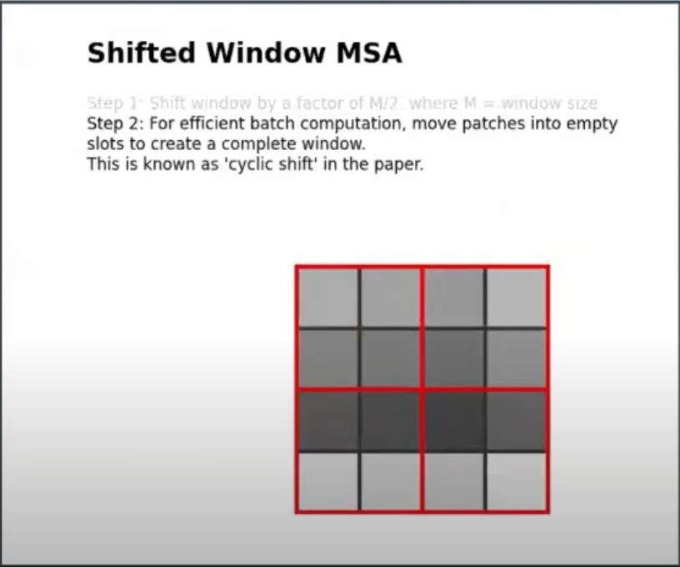
SHIFTED WINDOW BASED MSA
Window Position Shifting in Self-Attention Layers: The positions of the windows are slightly adjusted between self-attention layers to help the model gather more diverse contextual information from different parts of the image. This shifting process enhances the model's ability to capture relationships across the entire image.
Cyclic Shift: Windows are shifted slightly between layers to ensure that each layer focuses on different parts of the image, enhancing the model’s ability to understand the entire image. This slight shift helps in capturing relationships between adjacent patches, improving the overall feature representation.

Slide 22
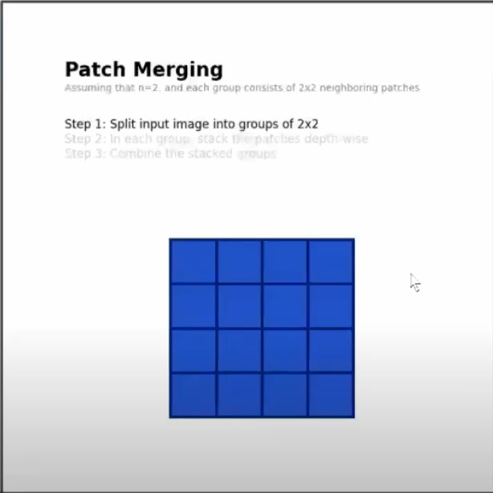
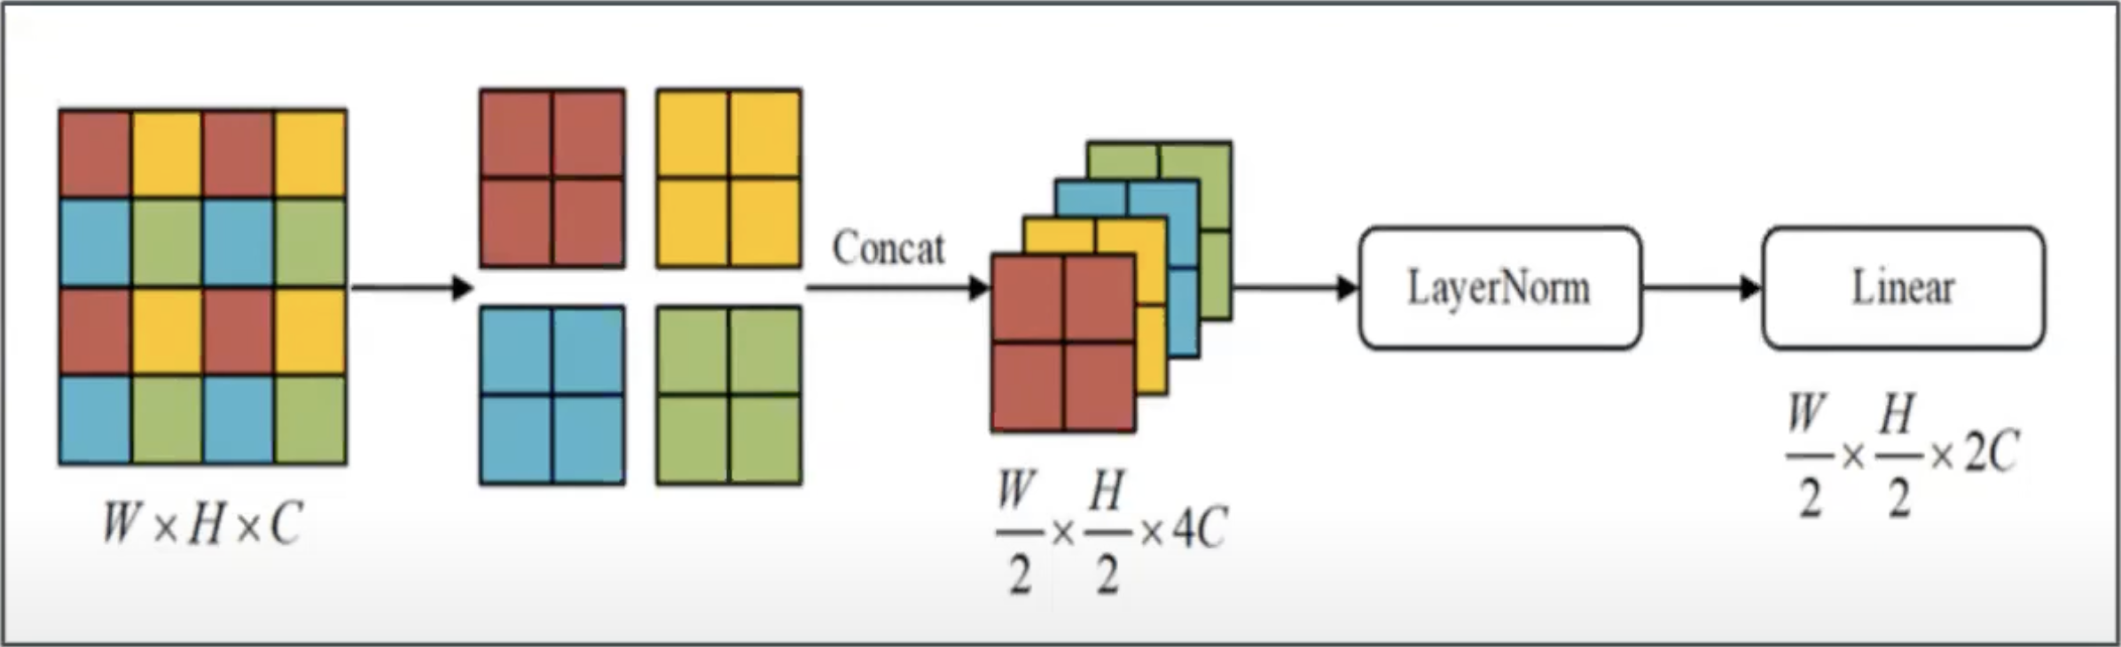
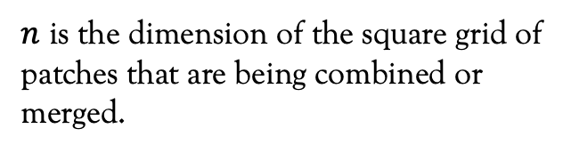
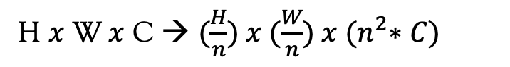
PATCH MERGING
Combining Patches: Groups of 2x2 neighboring patches are combined.
Concatenation: The features of these patches are concatenated to form a richer, more informative representation.
Dimensionality Adjustment: After concatenation, the number of patches is reduced, and the depth of the feature map is increased.
Patch merging combines smaller patches into larger ones, making the model more efficient and improving performance by reducing data.
H $x$ W $x$ C → $(\frac{H}{n}) x (\frac{W}{n}) x {(n}^{2}∗C)$
$n$ is the dimension of the square grid of patches that are being combined or merged.

Slide 23
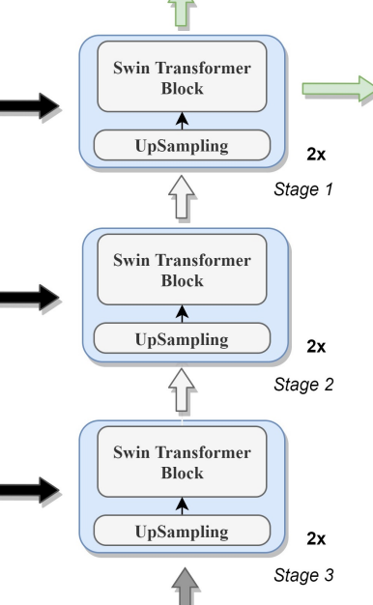
DECODER
The decoder in DS-TransUNet is designed to enhance the reconstruction of segmentation maps by integrating Swin Transformer blocks, leveraging both up-sampling and skip connections from the encoder.
Decoder Structure:
The decoder consists of three main stages, each involving up-sampling, concatenation with skip connection features from the encoder, and Swin Transformer blocks.
Stage Description:
At each stage, the input features are up-sampled by a factor of 2.
These up-sampled features are concatenated with corresponding skip connection feature maps from the encoder.
The combined features are then processed by a Swin Transformer block to enhance the feature representation by capturing local details and contextual information.

Slide 24
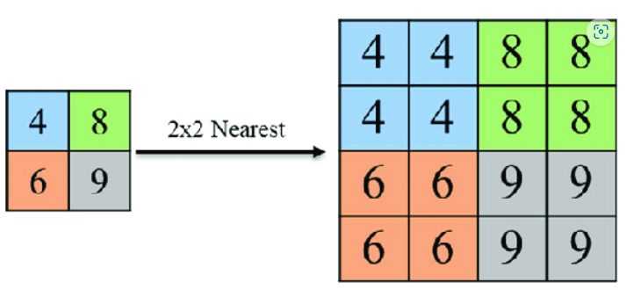
UP SAMPLING

Slide 25
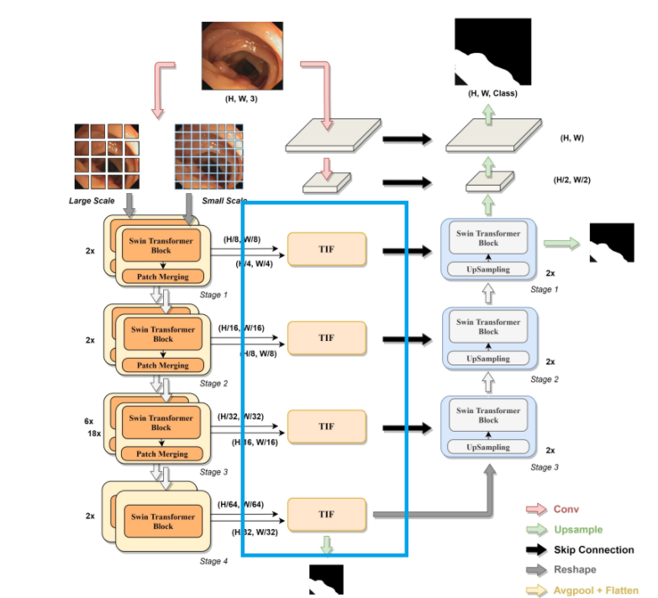
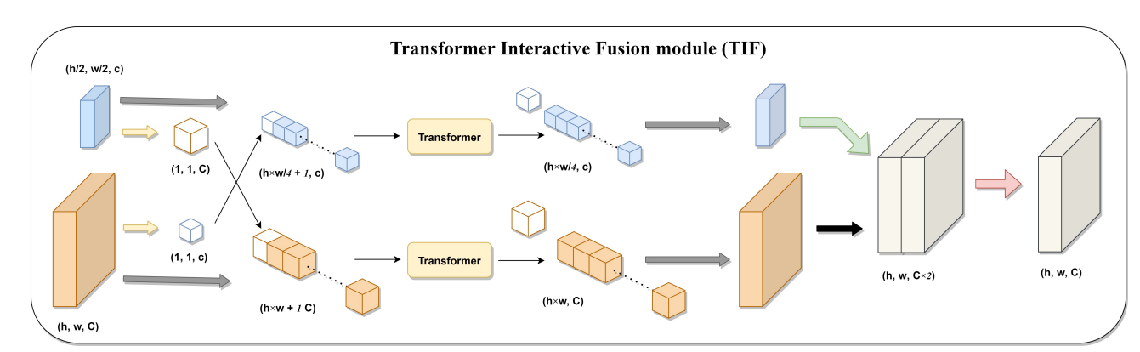
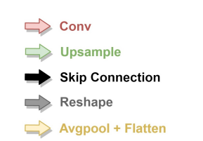
Transformer Interactive Fusion Module (TIF)
Notes:
The TIF module integrates features from different scales using transformer mechanisms. It enables effective interaction between multi-scale features, capturing long-range dependencies and global context

Slide 26
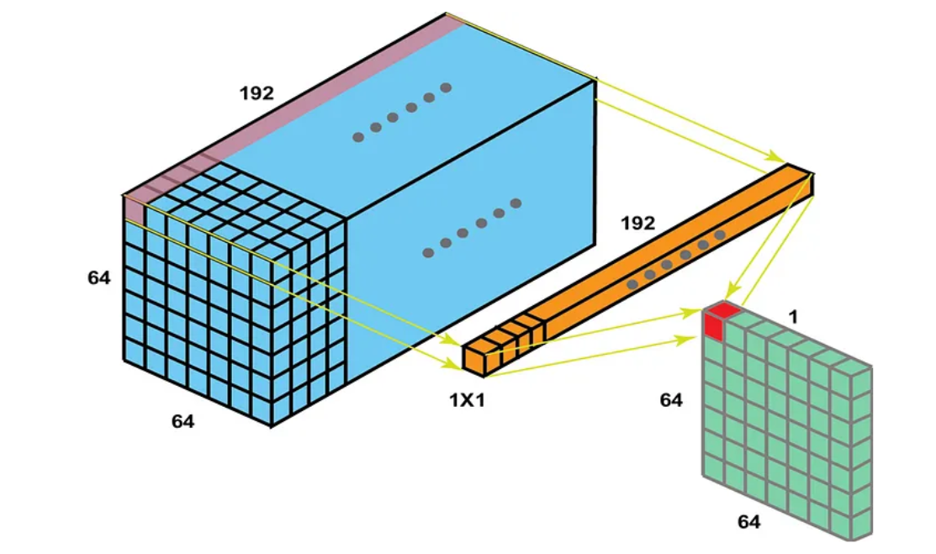
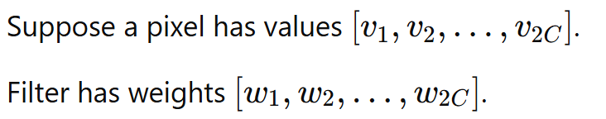
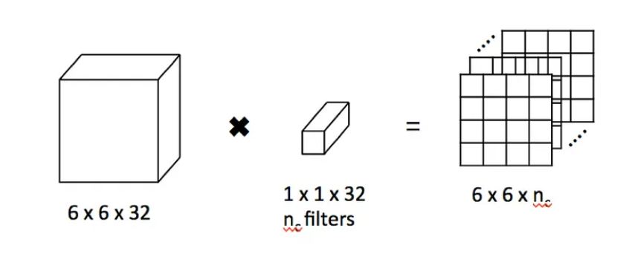
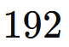
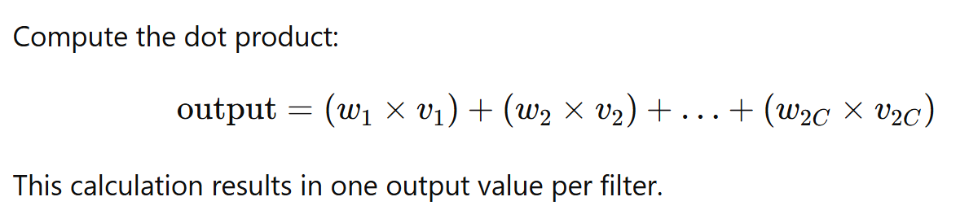
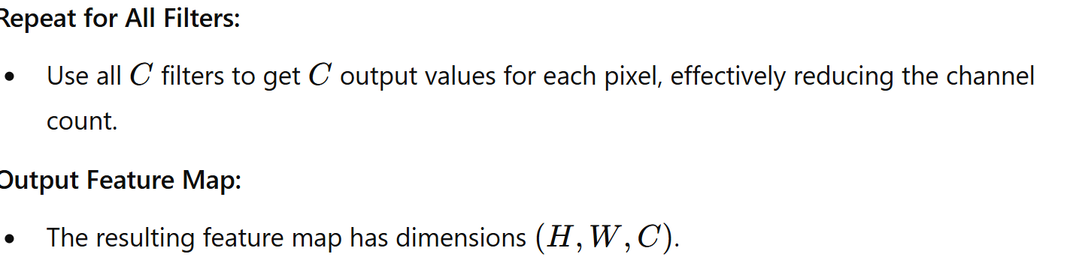
1×1 Convolution:

Slide 27
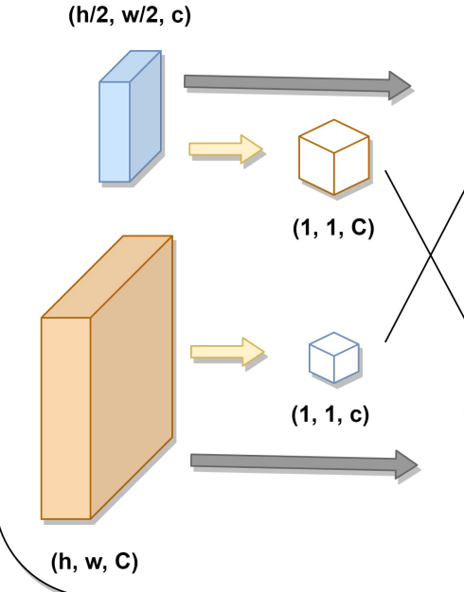
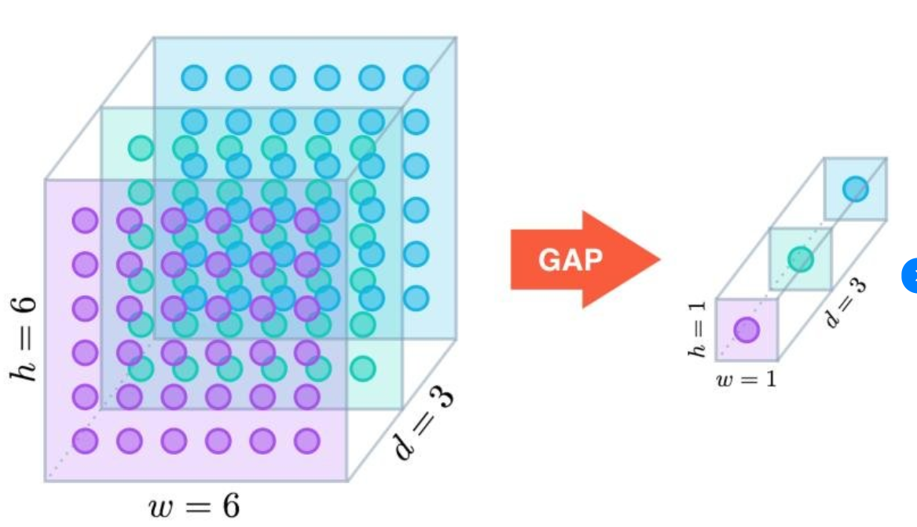
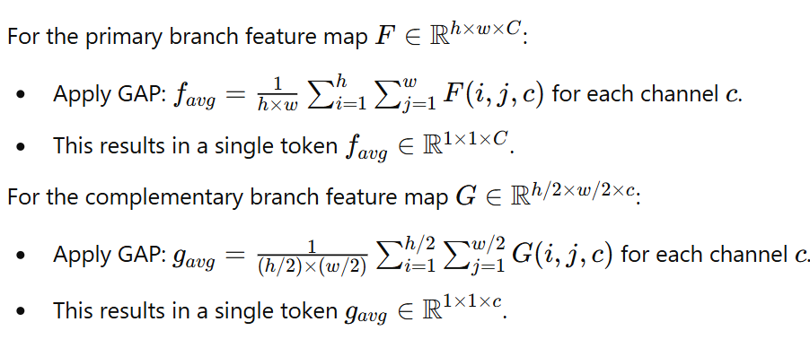
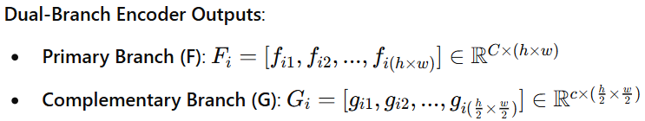
Global Average Pooling (GAP)
h stands for height, w stands for width, c stands for channels
Notes:
h = height of the feature mapwww = width of the feature mapCCC = number of channels (depth) in the feature map
For each channel in the feature map:Sum all the pixel values within that channel.
Calculate the average of these summed values. This is done by dividing the total sum by the number of pixels in the spatial dimension (h×wh \times wh×w).
If a neural network layer outputs 512512512 channels but a subsequent layer requires only 256256256 channels, a 1×11 \times 11×1 convolution with 256256256 filters can be applied. Each of the 256256256 filters learns to map the 512512512 input channels to a single output channel, effectively halving the channel depth while potentially capturing new, useful feature combinations based on the learned filter weights.

Slide 28
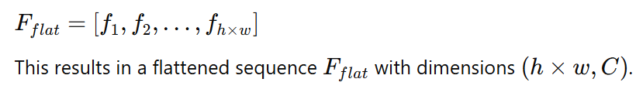
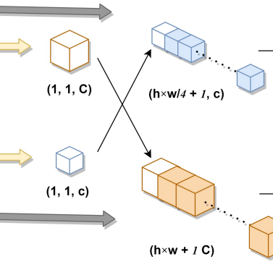
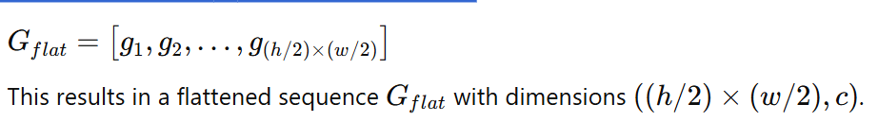
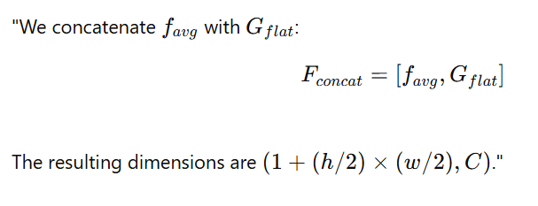
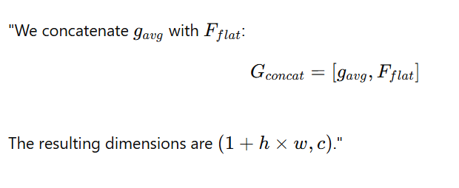
Flattening Operation:
Primary Branch:
Flatten the feature map F to create a sequence
Complementary Branch:
Flatten the feature map G to create a sequence:
Concatenation:
The concatenation enables interaction between the details features and the global context, and balance it to capture all the information
Notes:
Flattening involves converting this 3D tensor into a 1D array or vector. This is done by taking each row of pixels in each channel and laying them end-to-end in a single, long vector.
Step-by-Step Process:
Row-major Order: In most deep learning frameworks, the flattening is performed in row-major order. This means that the elements of each row are placed consecutively, followed by the elements of the next row, and so on, until all rows in the feature map are processed.
The GAP-generated context token (a 1×1×c1 \times 1 \times c1×1×c tensor, flattened to a vector of length ccc) is concatenated at the beginning or the end of the flattened feature vector from each branch
The primary goal of this concatenation is to allow the detailed primary branch features to interact with the abstract global information from the complementary branch at the pixel level. This enhances the feature fusion process, ensuring that the primary features can be interpreted with a broader context provided by the complementary features.Such an approach allows the Transformer to compute self-attention over a sequence that includes both local detailed information and global context, enhancing its ability to discern relevant features across different scales effectively.

Slide 29
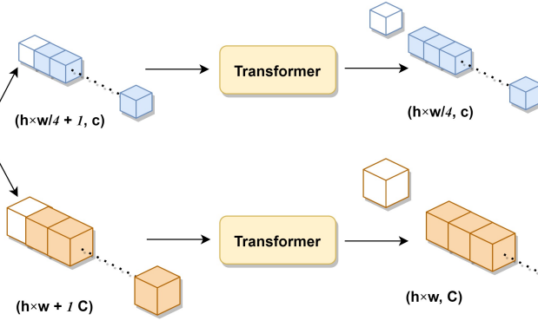
The concatenated sequences from both the primary and complementary branches are fed into the Transformer to capturing details and abstract global context .
Transformer Layer: The Transformer layer processes these sequences to compute global self-attention. This step ensures that each token in the sequence attends to every other token, capturing long-range dependencies and contextual information.
Notes:
In this step, the concatenated sequences from both the primary and complementary branches are fed into the Transformer layer. The primary branch sequence includes favgf_{\text{avg}}favg​ followed by the flattened feature tokens, and the complementary branch sequence includes gavgg_{\text{avg}}gavg​ followed by its flattened tokens.""The Transformer layer processes these sequences to compute global self-attention, ensuring that each token can attend to every other token in the sequence, capturing long-range dependencies and contextual information.""For the primary branch, the Transformer output has dimensions (h×w+1,C)(h \times w + 1, C)(h×w+1,C), and for the complementary branch, it has dimensions (h/4×w/4+1,c)(h/4 \times w/4 + 1, c)(h/4×w/4+1,c).“
"After the Transformer processes the concatenated sequences, we need to separate the global tokens favgf_{\text{avg}}favg​ and gavgg_{\text{avg}}gavg​ from the rest of the flattened sequences.""For the primary branch, the Transformer output is a sequence that starts with favgf_{\text{avg}}favg​, followed by the transformed flattened feature tokens.""Similarly, for the complementary branch, the output sequence begins with gavgg_{\text{avg}}gavg​, followed by the corresponding transformed tokens.""Mathematically, this is represented as FoutF_{\text{out}}Fout​ for the primary branch and GoutG_{\text{out}}Gout​ for the complementary branch, where the first tokens are the global averages.""This separation ensures that we retain both global context and detailed spatial information for the fusion step.“
The TIF module utilizes the standard Transformer block instead of the Swin Transformer block
Reason: The standard Transformer block can generate a token at a specified size based on one branch's feature map and compute self-attention with the token sequence reshaped by another branch.

Slide 30
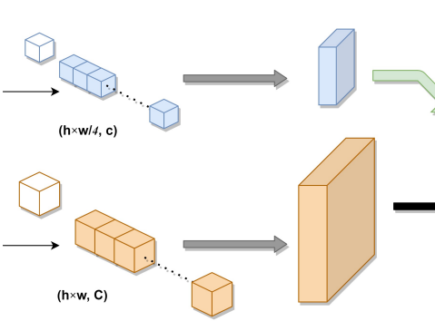
Reshaping to the original sizes, to ensures that the details and the global information are not just mixed but also aligning accurately with their respective locations in the original image
Notes:
Post-Transformer processing, the feature sequences are typically reshaped back into their original spatial formats (though this step is not explicitly shown in the image, it is implied). This reshaping is critical for maintaining the spatial integrity of the features, ensuring that they can be effectively used in subsequent segmentation tasks.

Slide 31
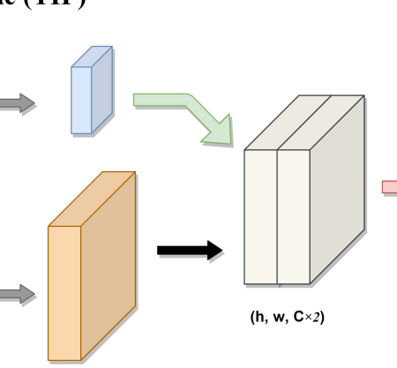
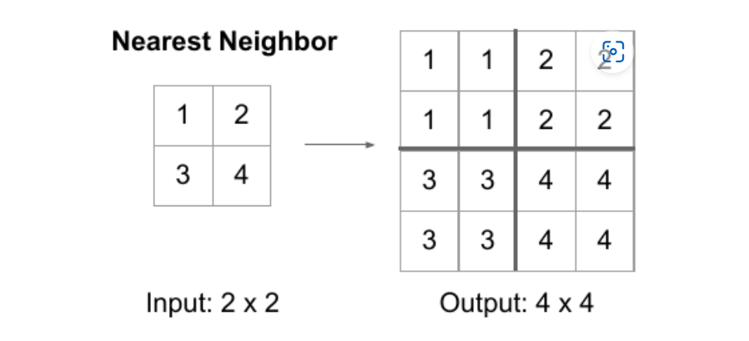
Notes:
Receiving Features from Transformer Blocks:
The processed features from the primary branch (orange block) and complementary branch (blue block) are received after passing through the Transformer blocks. These features have the dimensions (h,w,C)(h, w, C)(h,w,C) for the primary branch and (h/2,w/2,c)(h/2, w/2, c)(h/2,w/2,c) for the complementary branch.
Upsampling the Complementary Branch:
The complementary branch feature map (h/2,w/2,c)(h/2, w/2, c)(h/2,w/2,c) is upsampled to match the spatial dimensions of the primary branch feature map (h,w,c)(h, w, c)(h,w,c).
The upsampling operation increases the resolution, making the dimensions of the complementary branch feature map (h,w,c)(h, w, c)(h,w,c).
1. Nearest Neighbor Upsampling:
This is a simple method where each pixel is replicated to create a larger image.
For example, if you have a 2×22 \times 22×2 image and you want to upsample it to 4×44 \times 44×4, each pixel in the 2×22 \times 22×2 image is repeated in a 2×22 \times 22×2 block.
Concatenation:
The upsampled complementary branch feature map (h,w,c)(h, w, c)(h,w,c) is concatenated with the primary branch feature map (h,w,C)(h, w, C)(h,w,C) along the channel dimension.
This concatenation results in a combined feature map with dimensions (h,w,C+c)(h, w, C + c)(h,w,C+c).

Slide 32
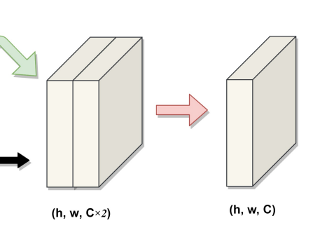
Notes:
Convolution Operation:
A convolution layer is applied to the combined feature map (h,w,C+c)(h, w, C + c)(h,w,C+c).
The purpose of this convolution is to reduce the channel dimension from C+cC + cC+c to CCC.
This operation produces the final fused feature map with dimensions (h,w,C)(h, w, C)(h,w,C).
1×1 Convolution:
Purpose: The 1×1 convolution is applied to reduce the number of channels back to the original size CCC, from C×2C×2C×2. This operation is crucial for combining the features effectively while maintaining the same spatial resolution.
Filter Size: The kernel used is 1×1, meaning it looks at one pixel at a time but across all channels.
Operation: This convolution operation involves sliding a 1×1 filter across the entire (h, w) spatial dimensions of the feature map. At each position, it performs a dot product between the filter's weights and the input channels, producing a single output value.
Output: The result is a feature map of size (h, w, C), where the spatial resolution remains the same, but the channel dimension is reduced.

Slide 33
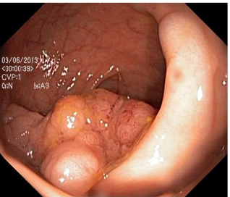
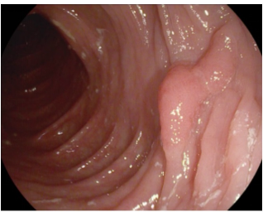
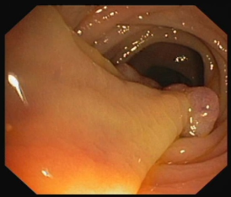



Datasets and Evaluation
To evaluate DS-TransUNet's learning and generalization, experiments were conducted on four medical image segmentation tasks using publicly available datasets, comparing results with other SOTA methods. Below are brief details on the datasets, evaluation metrics, and implementation.
1. Polyp Segmentation
Datasets: Kvasir, CVC-ClinicDB, EndoScene, ETIS, CVC-ColonDB
Preprocessing: Resized images to 512x512 or 384x384
2. Skin Lesion Analysis
Dataset: ISIC 2018
Details: 2596 images, resized to 256x256
3. Gland Segmentation
Dataset: GLAS
Details: 165 images, resized to 128x128
4. Nuclei Detection
Dataset: 2018 Data Science Bowl
Details: 670 images, resized to 256x256

Slide 34



Evaluation Metrics
Introduction:
To compare SOTA methods with our proposed DS-TransUNet, we use standard evaluation metrics: mean Dice Coefficient (mDice), mean Intersection over Union (mIoU), precision, and recall. These metrics are based on the values of true-positive (TP), false-positive (FP), and false-negative (FN).
Mean Dice Coefficient (mDice) Mean Intersection over Union (mIoU)
mDice = $\frac{2 x TP}{2 x TP+FP+FN}$ = $\frac{\text{2}\text{×}\text{∣}\text{Prediction}\text{∩}\text{Ground} \text{Truth}\text{∣}}{\text{∣}\text{Prediction}\text{∣}\text{+}\text{∣}\text{Ground} \text{Truth}\text{∣}}$ mIoU = $\frac{TP}{TP+FP+FN}$
Precision Recall
Precision = $\frac{TP}{TP+FP}$ Recall = $\frac{TP}{TP+FN}$

Slide 35

Performance on Polyp Segmentation

Slide 36




Slide 37





Slide 38
Conclusion Dual Swin Transformer U-Net (DS-TransUNet)
Innovative Framework: U-shaped encoder-decoder for medical image segmentation.
Based on Hierarchical Swin Transformer:
Encoder: Utilizes Swin Transformer blocks.
Decoder: Includes Swin Transformer blocks for enhanced performance.
Dual-Branch Encoder: Extracts multi-scale feature representations.
Transformer Interactive Fusion (TIF) Module:
Builds long-range dependencies between features of different scales.
Utilizes self-attention mechanism for effective feature fusion.
Performance:
Conducted on four medical image segmentation tasks.
Outstanding Results: Significantly outperforms other state-of-the-art methods.
Polyp Segmentation: Notable performance improvement.
Future Directions:
Lightweight Models: Researchers aim to design more efficient Transformer-based models.
Enhanced Learning: Focus on better learning of pixel-level intrinsic structural features.

Slide 39
Thank You For Your Attention!

